Slide 1

Robust control design by scenario optimization
Roberto Rocchetta, PhD
DEPARTMENT OF MATHEMATICS AND COMPUTER SCIENCE
STOCHASTIC OPERATIONS RESEARCH
Acknowledge Dr Luis G. Crespo, Dr Sean P. Kenny for the kind support
B. Wie and D. S. Bernstein, "Benchmark Problems for Robust Control Design," in 1991 American Control Conference, 1991

Slide 2
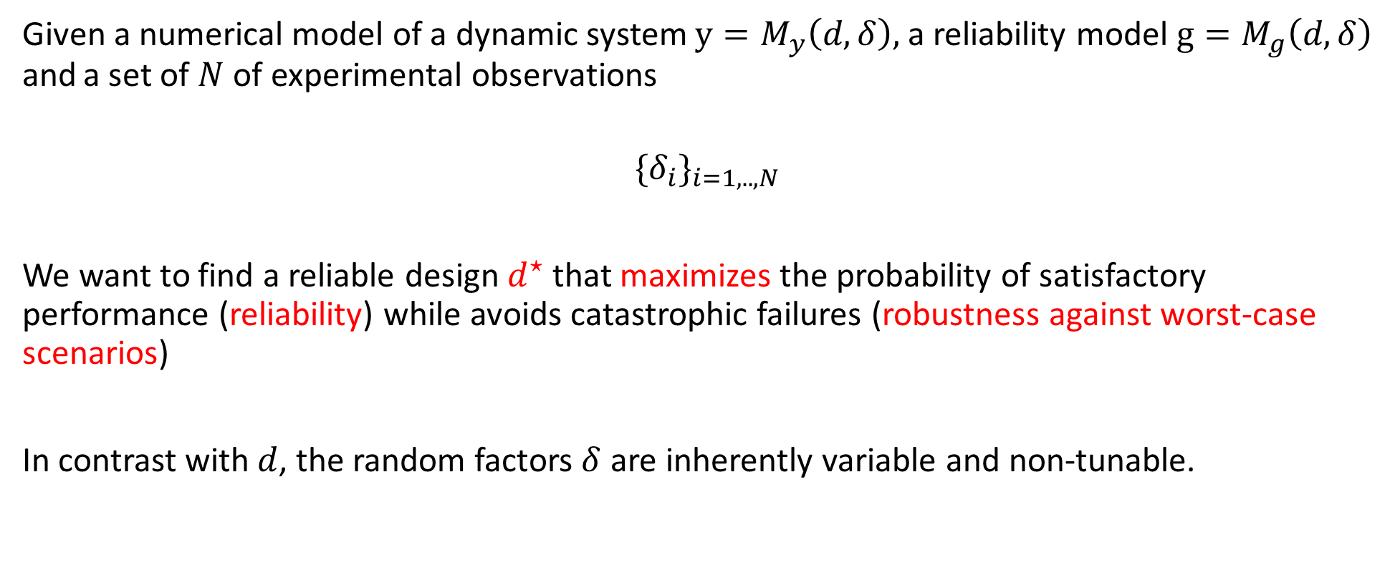
Problem statement
Given a numerical model of a dynamic system $y=M_{y}\left(d,δ\right),$ a reliability model $g=M_{g}\left(d,δ\right)$ and a set of $N$ of experimental observations
$$\{δ_{i}\}_{i=1,..,N}$$
We want to find a reliable design $d^{⋆}$ that maximizes the probability of satisfactory performance (reliability) while avoids catastrophic failures (robustness against worst-case scenarios)
In contrast with $d$, the random factors $δ$ are inherently variable and non-tunable.

Slide 3
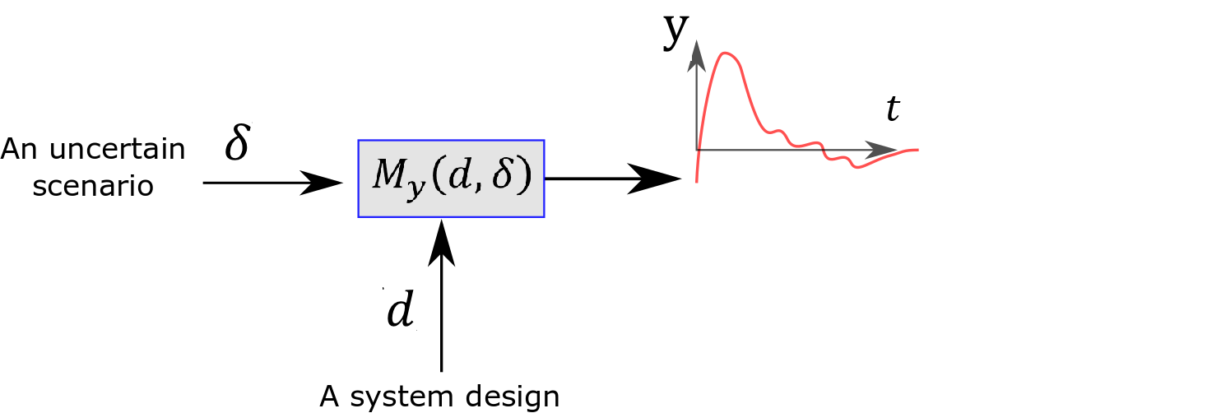
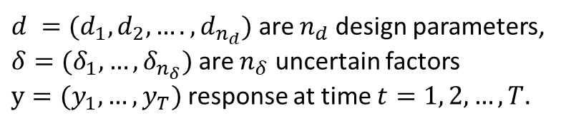

Problem statement
Different uncertain scenarios affect the system’s response
$$δ$$
$d =(d_{1},d_{2},….,d_{n_{d}})$ are $n_{d}$ design parameters,
$δ=(δ_{1},…,δ_{n_{δ}})$ are $n_{δ}$ uncertain factors
$y={(y}_{1},…,y_{T})$response at time $t=1, 2,…,T.$

Slide 4
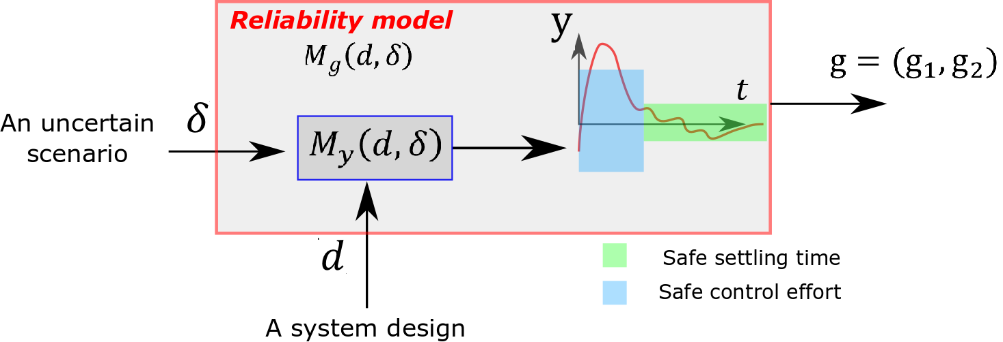
Problem statement
$g={(g}_{1},…,g_{n_{g}})$ is a vector of performance scores for $n_{g}$ reliability requirements.

Slide 5
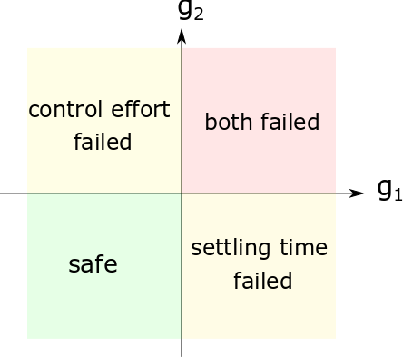
Problem statement
g1<0 (safe)
g2<0 (safe)
$g={(g}_{1},…,g_{n_{g}})$ is a vector of performance scores for $n_{g}$ reliability requirements.

Slide 6
Problem statement
g2>0 (failure)
g1<0 (safe)
g1<0 (safe)
g2<0 (safe)
$g={(g}_{1},…,g_{n_{g}})$ is a vector of performance scores for $n_{g}$ reliability requirements.

Slide 7
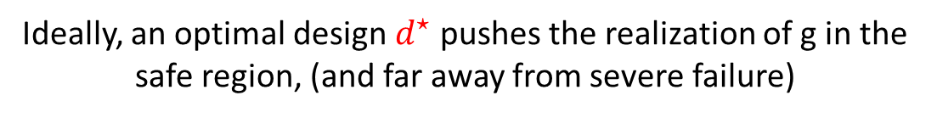
Problem statement
$$δ$$
g1<0 (safe)
g2<0 (safe)
Ideally, an optimal design $d^{⋆}$ pushes the realization of g in the safe region, (and far away from severe failure)

Slide 8

Problem statement
$$⋆$$
$$δ$$
g1<0 (safe)
g2<0 (safe)
Ideally, an optimal design $d^{⋆}$ pushes the realization of g in the safe region, (and far away from severe failure)

Slide 9
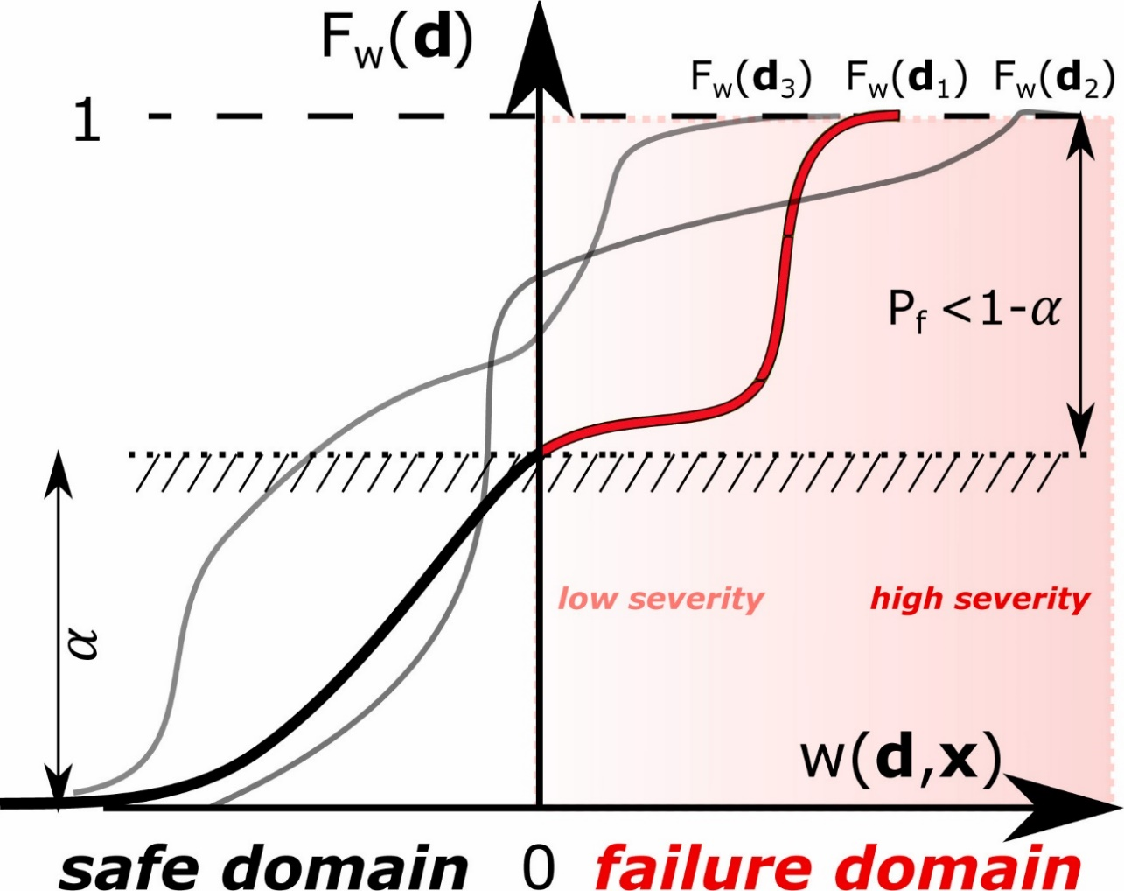



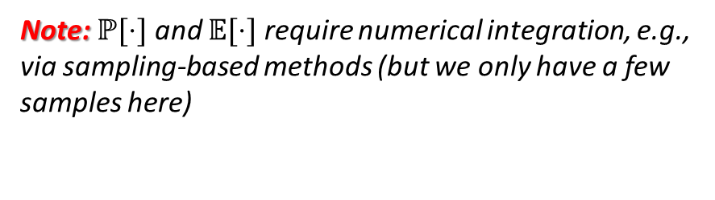
Robustness &Reliability Metrics
(to compare different designs)
Empirical cumulative distribution function
Worst-case performance score:
$w\left(d,δ\right)=\max_{i=1,..,n_{g}}{g_{i}}\left(d,δ\right)$;
Worst-case scenario score:
$\overline{g_{i}}\left(d\right)=\max_{k=1,..,N}{g_{i}}\left(d,δ_{k}\right)$
$\overline{w}\left(d\right)=\max_{k=1,..,N}{w}\left(d,δ_{k}\right)$
$$P_{f,all}<1−α$$
$$w\left(d,δ\right)$$
Note: $ℙ[⋅]$ and $𝔼[⋅]$ require numerical integration, e.g., via sampling-based methods (but we only have a few samples here)

Slide 10

Robustness &Reliability Metrics
(to compare different designs)
Empirical cumulative distribution function
Worst-case performance score:
$w\left(d,δ\right)=\max_{i=1,..,n_{g}}{g_{i}}\left(d,δ\right)$;
Worst-case scenario score:
$\overline{g_{i}}\left(d\right)=\max_{k=1,..,N}{g_{i}}\left(d,δ_{k}\right)$
$\overline{w}\left(d\right)=\max_{k=1,..,N}{w}\left(d,δ_{k}\right)$
Failure probability for individual and all requirements:
$P_{f,i}\left(d\right)=ℙ\left[g_{i}\left(d,δ\right)>0\right]$
$P_{f,all}\left(d\right)=ℙ[w(d,δ)>0]$
Severity for individual and all requirements:
$S_{i}\left(d\right)= 𝔼\left[g_{i}\left(d,δ\right) \right| g_{i}(d,δ)>0]$
$S_{all}\left(d\right)= 𝔼\left[w\left(d,δ\right) \right| w(d,δ)>0]$
$$P_{f,all}<1−α$$
$$w\left(d,δ\right)$$
Note: $ℙ[⋅]$ and $𝔼[⋅]$ require numerical integration, e.g., via sampling-based methods (but we only have a few samples here)

Slide 11
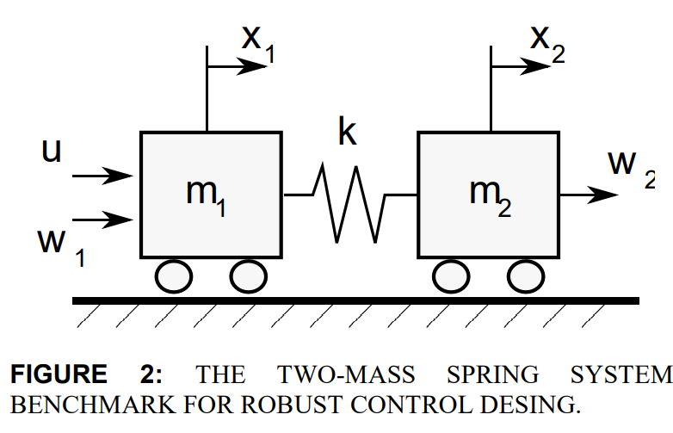
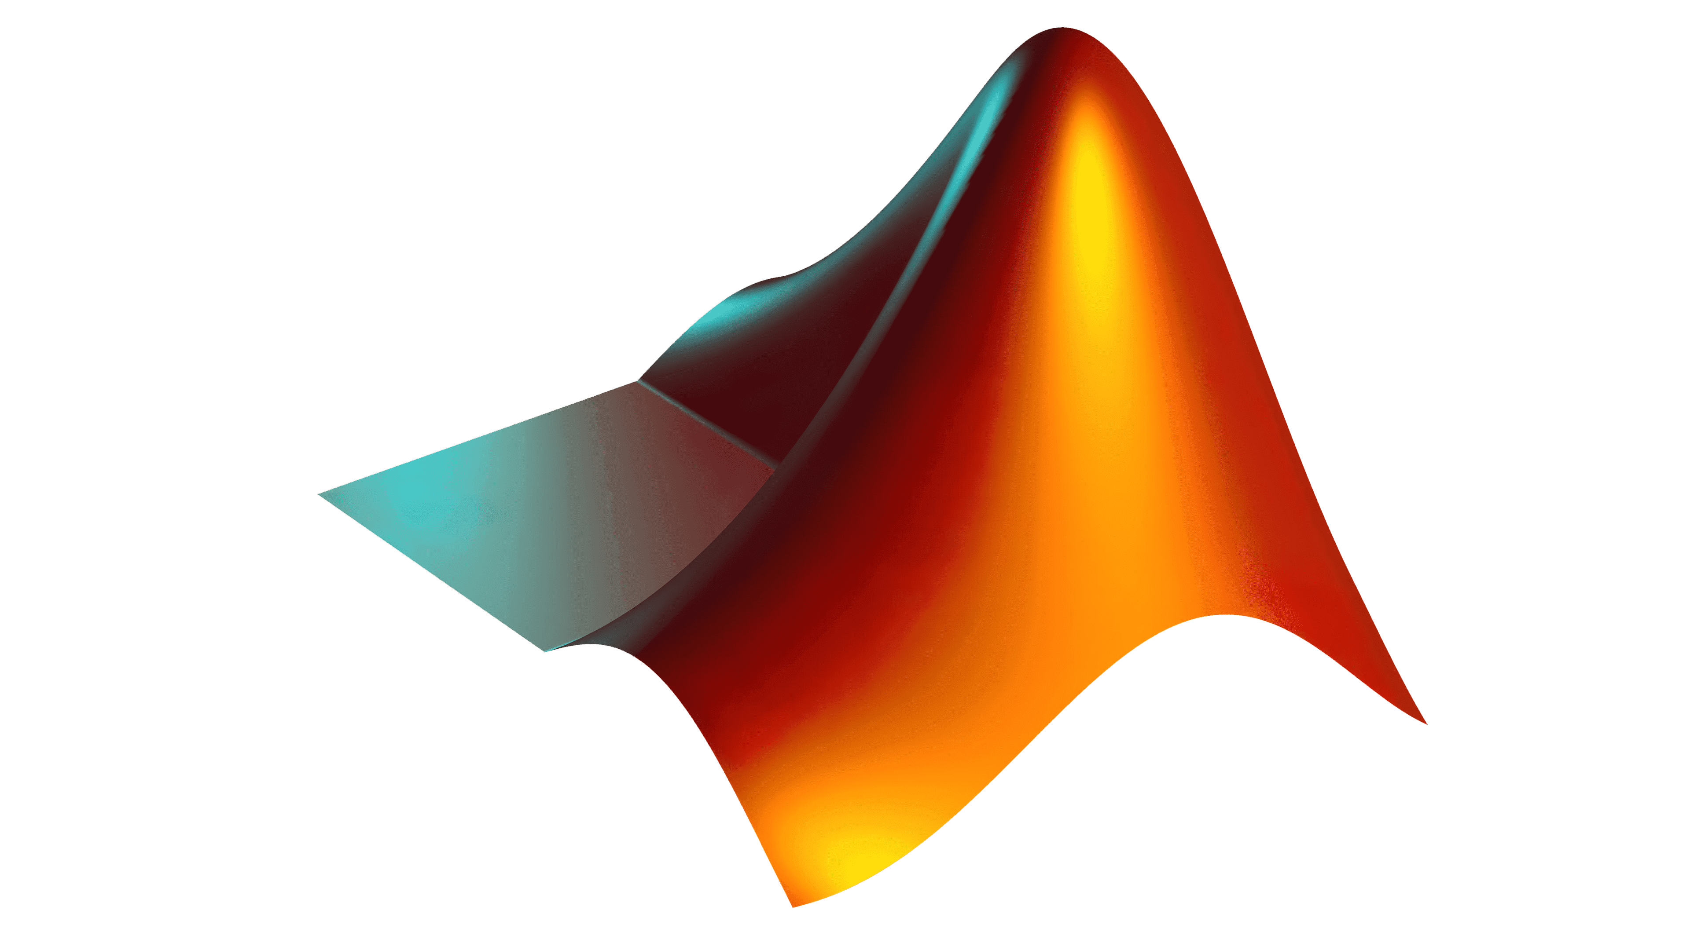

The challenge problem: Reliability-based design and reliability assessment of a controller
Goals:
Optimize the controller design for a two-mass spring system from given data.
Verify system reliability and robustness, e.g., reachability of failure domains and “severe” failure regions.
https://github.com/Roberock/ControllerRobust
.

Slide 12
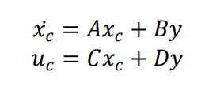
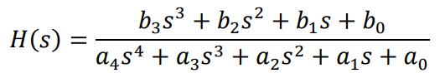
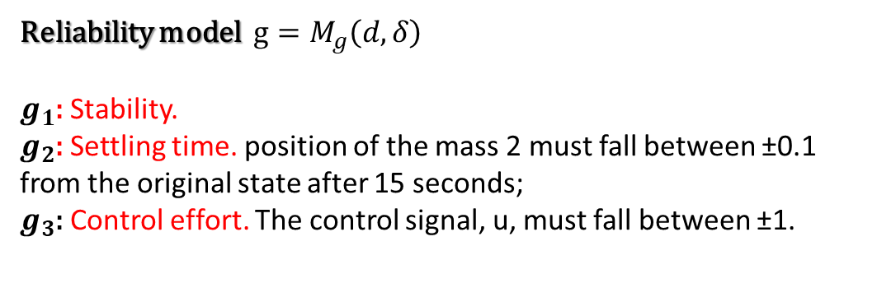

The challenge problem: Reliability and system model
Reliability model $g=M_{g}\left(d,δ\right)$
$g_{1}$: Stability.
$g_{2}$: Settling time. position of the mass 2 must fall between ±0.1 from the original state after 15 seconds;
$g_{3}$: Control effort. The control signal, u, must fall between ±1.
Note that the time domain requirements require simulating the time response of the system by numerical integration.
Dynamic model $M_{y}\left(d,δ\right):$
From canonical form to
transfer-function
https://github.com/Roberock/ControllerRobust
.

Slide 13
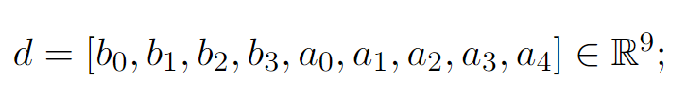
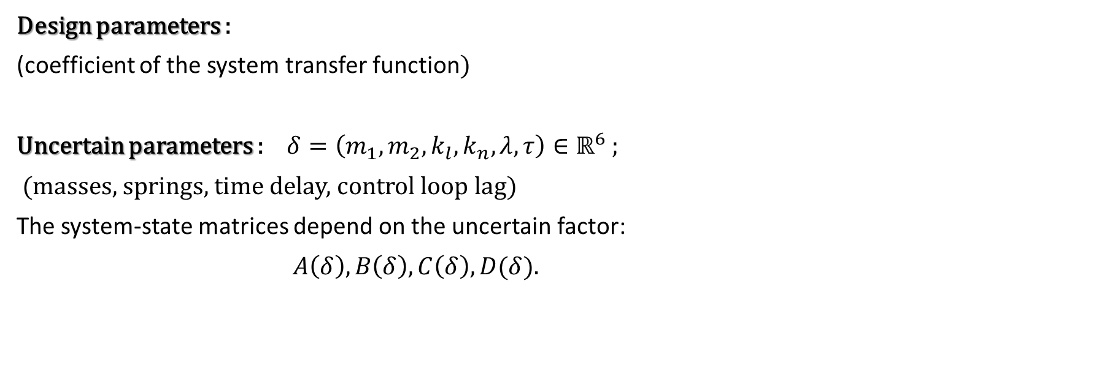
The challenge problem: Design parameters and uncertain factors
Design parameters :
(coefficient of the system transfer function)
Uncertain parameters : $δ=\left(m_{1},m_{2}, k_{l}, k_{n},λ,τ\right)∈ℝ^{6}$ ;
(masses, springs, time delay, control loop lag)
The system-state matrices depend on the uncertain factor:
$A\left(δ\right),B\left(δ\right),C\left(δ\right),D(δ)$.
https://github.com/Roberock/ControllerRobust

Slide 14
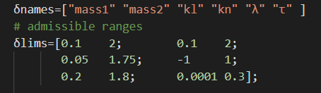


The data set: $D=\{δ_{i}\}_{i=1,..,N}$
Two data sets are provided:
$N$=1000 samples, large uncertainty
$N$=1000 samples, small uncertainty
*Bounds are provided
*Non-trivial dependency structures
https://github.com/Roberock/ControllerRobust

Slide 15
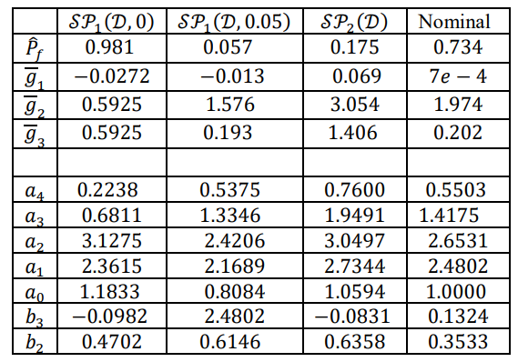

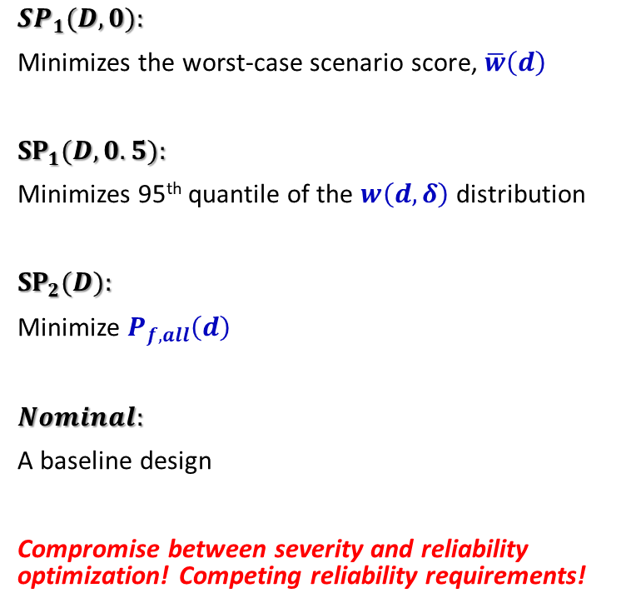
Four designs from [1]:
Designs Names
${SP}_{1}(D,0):$
Minimizes the worst-case scenario score, $\overline{w}\left(d\right)$
${SP}_{1}(D,0.5):$
Minimizes 95th quantile of the $w\left(d,δ\right)$ distribution
${SP}_{2}(D):$
Minimize $P_{f,all}\left(d\right)$
$Nominal:$
A baseline design
Compromise between severity and reliability optimization! Competing reliability requirements!
Scores
The design
parameters
https://github.com/Roberock/ControllerRobust
[1] Rocchetta, R., Crespo, L. G., & Kenny, S. P. (2019). Solution of the benchmark control problem by scenario optimization. In Dynamic Systems and Control Conference, USA.

Slide 16
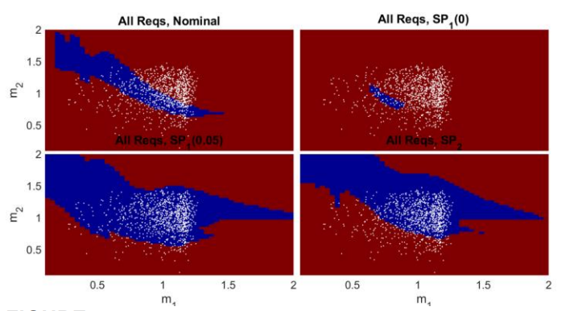

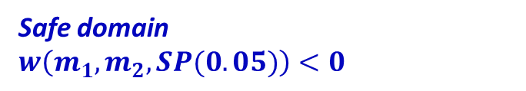
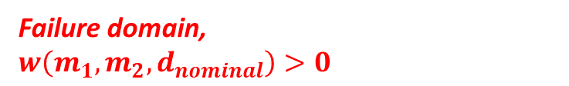
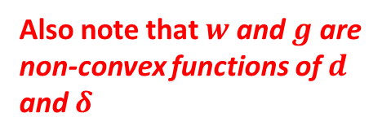


Design resulting from previous works [1]
Failure domain,
$w\left(m_{1},m_{2},d_{nominal}\right)>0$
Also note that $w$and $g$are non-convex functions of $d$ and $δ$
$Nominal$
${SP}_{1}(0)$
Samples
Mass second
body
Safe domain
$w\left(m_{1},m_{2},SP(0.05)\right)<0$
${SP}_{2}$
Mass first body
https://github.com/Roberock/ControllerRobust
[1] Rocchetta, R., Crespo, L. G., & Kenny, S. P. (2019). Solution of the benchmark control problem by scenario optimization. In Dynamic Systems and Control Conference, USA.

Slide 17
Concluding discussion on challenges a few remarks
Value of information & uncertainty characterization challenges:
How to use the available data in the best way? Shall we prescribe a model for the uncertainty?
How to keep track of the value of information in the initial data set (only 1k samples) ?
The data present some complex dependency structures. Can we account for this?
Reliability challenges:
Competing reliability requirements.
Robustness and reliability (competing)
Estimation of failure probability from set-based characterization (reachability of failure sets)
Robust vs Reliable design optimization challenges:
Need to define an appropriate optimization program (minimize or constrain severity/reliability/worst-cases?)
Probabilities and expectations are step-wise discontinuous (gradient based optimizer are inapplicable).
https://github.com/Roberock/ControllerRobust

Slide 18
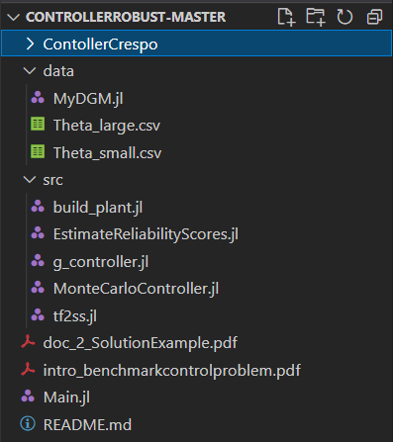

Thank you for listening!
[1] Rocchetta, R., Crespo, L. G., & Kenny, S. P. (2019). “Solution of the benchmark control problem by scenario optimization”, In Dynamic Systems and Control Conference, USA.
[2] B. Wie and D. S. Bernstein, "Benchmark Problems for Robust Control Design," in 1991 American Control Conference, 1991
[3] Roberto Rocchetta, Luis G. Crespo, Sean P. Kenny, “A scenario optimization approach to reliability-based design”, Reliability Engineering & System Safety, Volume 196, 2020, https://doi.org/10.1016/j.ress.2019.106755
[4] R. Rocchetta, Luis G. Crespo, “A scenario optimization approach to reliability-based and risk-based design: soft-constrained modulation of failure probability bounds”, Reliability Engineering & System Safety, https://doi.org/10.1016/j.ress.2021.107900

